Slide 1
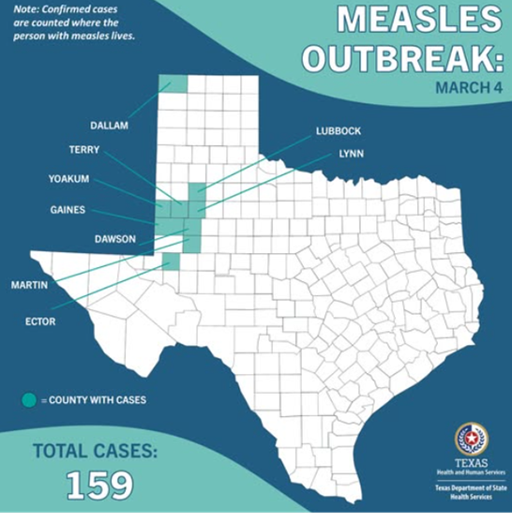



YALE ESF-8 VIRTUAL MEDICAL OPERATION CENTER (VMOC) SPECIAL REPORT
MEASLES OUTBREAK WEST TEXAS - 2025
BACKGROUND
LINKS
SIGNS, SYMPTOMS AND COMPLICATIONS
TEXAS LINKS
TEXAS DEPARTMENT OF HEALTH AND HUMAN SERVICES
FACEBOOK | X
HEALTH ALERTS
THE SOUTH PLAINS PUBLIC HEALTH DISTRICT
NEWS SOURCES
NEWSWEEK
NBC NEWS​
NPR​
OUTBREAK NEWS TODAY
PBS NEWS​
REUTERS
TX PUBLIC RADIO
USA TODAY​
WASHINGTON POST​
AP​
CBS NEWS​
CNN
DALLAS MORNING NEWS
FOX NEWS​
KCBD NEWS
KERA NEWS
NEW YORK TIMES
TIMELINE
CURRENT SITUATION
NEW MEXICO LINKS
NEW MEXICO DEPARTMENT OF HEALTH
NMDOH NEWS RELEASE
NMDOH GUIDANCE
BY THE NUMBERS
PORTALS, BLOGS, AND RESOURCES
CIDRAP
FORCE OF INFECTION
KHN
MEDPAGE TODAY
THE PANDEMIC CENTER TRACKING REPORT
YLE
MMR VACCINE
RESOURCES FOR THE PUBLIC
CDC – MEASLES
MEASLES CASES AND OUTBREAKS
NYSDOH: YOU CAN PREVENT MEASLES
CDC VIDEO: GET VACCINATED AND PREVENT MEASLES
CDC VACCINE SHOT FOR MEASLES
DIRECTORY FOR LOCAL HEALTH DEPARTMENTS
RESOURCES FOR EMS PROVIDERS
GUIDANCE FOR SUSPECTED MEASLES PATIENT
NYSDOH POLICY STATEMENT
HOSPITALS / CLINIC
LOCAL GOVERNMENT RESPONSE
RESOURCES FOR HEALTHCARE PROVIDERS
CDC – MEASLES FOR THE HEALTHCARE PROFESSIONALS
CDC VIDEO: MEASLES CLINICAL FEATURES AND DIAGNOSIS
CDC CLINICAL IMAGES OF MEASLES
CDC LABORATORY TESTING FOR MEASLES
CDC ROUTINE VACCINATION RECOMMENDATIONS
CDC ISOLATION RECOMMENDATIONS
CDC: MEASLES CONTROL IN HEALTHCARE SETTINGS
CDC ALERT SIGN INFOGRAPHIC
CDC POSTER FOR OFFICE DISPLAY
NY HEALTH; RECOGNIZING MEASLES FACT SHEET
NY HEALTH: DEALING WITH VACCINE HESITANCY
MEASLES POST-EXPOSURE PROPHYLAXIS
MEASLES REVIEW FOR PROVIDERS
MEASLES TESTING LABORATORIES
CDC MEASLES VIRUS LABORATORY
STATE RESPONSE
PRIORITY OF NEEDS
MORBIDITY AND MORTALITY
AS OF 3/4/2025
TEXAS
NEW MEXICO
NATIONAL STATS
CASES
159
9
RISK COMMUNICATIONS
*Situation is still developing. Numbers are expected to increase
HOSPITALIZATIONS
22
0
INFECTION CONTROL
DEATHS
1
CONTRIBUTORS
AS OF: 2200 HRS, 3/4/2025
Notes:
SINCE 1 JAN TEST RESULTS = 42,211(2006)
TOTAL TEST RESULTS SICNE 1 AUG: 169,332

Slide 2
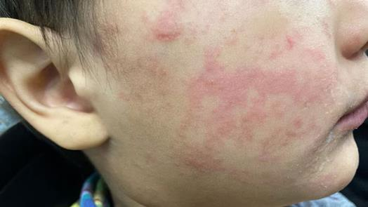
BACKGROUND
TYPE OF PUBLIC HEALTH EMERGENCY: WEST TX MEASLES OUTBREAK
BACKGROUND: The West Texas measles outbreak—the largest in the state in 30 years—has grown from two cases in late January to 159 cases across nine counties, primarily in the rural South Plains region. The virus has also spread into eastern New Mexico. Among those infected in Texas, five were vaccinated, while the rest were either unvaccinated or had an unknown vaccination status. Based on 2023–2024 data, Gaines County, TX, had one of the highest vaccination exemption rates, at nearly 18%. The outbreak initially centered around members of the Mennonite community before expanding further.
LOCATIONS: Since January, the outbreak has spread to other Texas counties, including Dallam, Dawson, Ector, Gaines, Lubbock, Martin, Terry, and Yoakum. In February, it spread to Lea County in New Mexico.
CASES: 159 Cases in TX
9 Cases in NM
HOSPITALIZATIONS: 22
FATALITIES: 1 The Texas Department of State Health Services reported the death of an unvaccinated “school-aged” child on Wednesday, 2/26/2025. The child did not have any underlying health issues. This is the first measles death in the United States since 2015.
INVESTIGATION:
  The Texas Department of State Health Services (DSHS) works with local health departments to investigate the outbreak. Due to the highly contagious nature of this disease, additional cases are likely to occur in the outbreak area and the surrounding communities. ​
  The New Mexico Department of Health (NMDOH) is actively reaching out to individuals identified as potentially exposed to the measles cases in Lea County. By providing guidance, they aim to prevent further spread of the infection.
The child’s cheek shows the characteristic rash associated with measles. Source: CDC
WEST TEXAS OUTBREAK
0-4 Years | 5-17 Years | 18+ Years | Pending | Total
53 (33.3%) | 74 (46.5%) | 27 (17%) | 5 (3.2%) | 159
NEW MEXICO OUTBREAK
0-4 Years | 5-17 Years | 18+ Years | Pending | Total
0 | 4 (44.5%) | 5(55.5%) | 0 | 9
TEXAS DEPARTMENT OF HEALTH AND HUMAN SERVICES
NEW MEXICO DEPARTMENT OF HEALTH

Slide 3
SIGNS, SYMPTOMS, AND COMPLICATIONS
WHO IS AT RISK: Measles can be serious in any age group; however, the following are at increased risk of complications from measles:
  Infants and children younger than 5 years of age
  Undernourished children (particularly those with Vitamin A deficiency)
  Pregnant women
  People with weakened immune systems (HIV/AIDS, cancer, or undergoing chemotherapy)
COMMON SERIOUS COMPLICATIONS OF MEASLES:
Pneumonia (lung infection): most common cause of measles-related death in children and can occur in 1-6% of cases.
Otitis media (ear infection): occurs in 7-9% of patients and can lead to hearing loss.
Diarrhea: affects 8% of patients and can lead to severe dehydration.
Encephalitis (inflammation of the brain): occurs in 1 per 1,000 cases and can result in permanent brain damage (intellectual disability, seizures, blindness, deafness).
Pregnancy complications: increased risk of miscarriage, preterm birth, low birth weight, and maternal death.
Acute respiratory distress syndrome (ARDS): life-threatening breathing problem requiring mechanical ventilation (breathing machine) and high risk of death.
Sepsis (overwhelming infection): measles weakens the immune system, leading to secondary bacterial infection, which is a significant cause of death in measles patients.
LONG-TERM COMPLICATION:
Subacute sclerosing panencephalitis (SSPE) is a rare but progressive and fatal neurological disorder resulting from a measles virus infection earlier in life. Typically presents 5-10 years after the initial measles infection (even though the person seemed to have fully recovered from it). There is a higher risk of developing SSPE if one had measles before 2 years of age.
INCUBATION PERIOD: 10–14 days (up to 20 days) after contact with the virus, before symptoms start
A person with measles is contagious even in the absence of symptoms, which spans the latter part of the incubation period (4 days before the onset of rash, until 4 days after the rash appears).
PRODROMAL PHASE: First symptoms appear (lasts 2-4 days)
Symptoms resemble those of upper respiratory tract infection:
High fever (may spike up to 105°F or 40.6 °C)
3 Cs of measles: cough, coryza (runny nose), conjunctivitis (red, watery eyes)
Sore throat
Koplik spots: small bluish-white spots may appear inside the mouth 1-2 days before onset of rash and persist for 1-2 days after rash appears. Highly specific sign of measles.
RASH PHASE: 2-4 days after symptoms begin
Measles rash (flat to raised red spots) appears 2-4 days after fever onset. Begins on the face and head, then spreads to the trunk and extremities, and may become confluent. Fades in the order it appeared over 3-5 days.
Fever may continue or worsen
3 Cs persist
Other symptoms: headache, muscle aches, sensitivity to light, diarrhea
RECOVERY PHASE (if uncomplicated): Full recovery within 7 days after onset of rash
Rash fades, and patient gradually returns to normal health.
Source: CDC, NEJM, WHO

Slide 4
2025 WEST TEXAS MEASLES OUTBREAK TIMELINE (TX & NM)
1/29/25 - South Plains Public Health District reports a measles case in Gaines County: The public was notified about a measles case in an unvaccinated Gaines County school age child.
1/30/25 - An additional measles case is reported in Gaines County: An additional unvaccinated school-age child is identified as having measles in Gaines County. Both cases are reported as having been hospitalized in Lubbock and having been discharged.
2/3/25 - New Mexico releases a measles health alert: NMDOH issues a health alert concerning risk for measles exposure within New Mexico’s Lea County and residents crossing state lines. New Mexico residents are urged to confirm vaccination records and to get vaccinated.
2/5/25 - Texas DSHS first reports a Texas measles outbreak: The outbreak of measles was described as six cases all among unvaccinated school-aged children from Gaines County. DSHS confirms no connection between Harris County and Gaines County cases.
2/11/25 - First measles case is reported in New Mexico: The NMDOH Scientific Laboratory confirmed a measles case in an unvaccinated Lea County teenager.
2/14/25 - NMDOH first reports a New Mexico measles outbreak: The New Mexico Department of Health officially reports a measles outbreak in Lea County, bringing the total cases of confirmed measles to 3 cases.
2/14/25 - 2/16/25 - In Texas, an individual later diagnosed with measles travels while contagious: An individual who was later diagnosed with measles visited locations in San Marcos, San Antonio, and New Braunfels while contagious. Locations included one tourist attraction, two universities, two restaurants, and two convenience stores.
2/24/25 - Texas DSHS releases a health alert for measles exposures in Central & South-Central Texas: DSHS reports that multiple health departments in Central and South-Central Texas have reported measles exposures related to the Gaines County outbreak tied to an individual’s travel from 2/14 to 2/16.
2/25/25 - Reported cases of measles in Texas increase to 124: DSHS reports 124 confirmed cases of measles in the ongoing outbreak. Regions included in the outbreak expand to include the South Plains and Panhandle regions.
2/26/25 - Texas announces first death in measles outbreak: DSHS reports the death of a school-aged child who was unvaccinated and had been hospitalized in Lubbock. 18 people are reported as being hospitalized over the course of the outbreak.
2/28/25 - Texas DSHS updates outbreak to 146 cases, 1 fatality: The measles outbreak is defined as including the South Plains region of Texas. 20 individuals are reported as being hospitalized. The outbreak is defined as being predominantly among 0–4-year-olds.
2/28/25 - NMDOH updates outbreak to 9 cases: The measles outbreak is defined as including New Mexico’s Lea County and includes nine cases predominantly in 5-17 and 18+ year olds.
3/4/25 - Texas DSHS updates outbreak to 159 cases, 1 fatality: 22 individuals are reported as being hospitalized.
SOURCES: Texas DSHS, NMDOH

Slide 5
CURRENT SITUATION
LATEST UPDATE: On 3/4/2025, the Texas Department of State Health Services reported that the number of cases had risen to 159, primarily among children, including 22 hospitalizations and one fatality in a school-aged child. Most cases are among residents of Gaines County, where the outbreak appears to have originated within a Mennonite community.
VACCINATION RATES: Vaccination rates are notably low in the most affected areas. Gaines County vaccination rates are significantly below the threshold required for herd immunity, contributing to the virus’s rapid spread. In the county, one in five students is not vaccinated for measles, mumps, or rubella (MMR).
CONTACT TRACING: Texas and New Mexico are conducting contact tracing to identify and track positive cases and inform people who may have been exposed.
RESPONSE: Local county health departments advise those exposed to shelter-in-place to contact their healthcare provider. They also offer vaccination clinics for measles, mumps, and rubella (MMR). The Texas Department of State Health Services (DSHS) and the New Mexico Department of Health (NMDOH) are tracking cases and recommend MMR vaccination for unvaccinated individuals residing in counties with active cases. These departments are also providing laboratory testing services. As of 3/4/2025, the CDC’s Epidemic Intelligence Service (EIS) is partnering with Texas government officials to respond to the outbreak, referred to as Epi-Aid. There are also efforts to acquire more measles vaccines and collaboration with hospitals to prepare for the increasing number of cases.
CURRENT SITUATIONAL CHALLENGES: Measles is transmissible before symptoms appear, increasing the risk of spreading the virus to others. The virus can linger in the air for up to two hours after an infected person sneezes or coughs. Many cases are likely being missed and underreported and the outbreak is expected to worsen before improving. Additionally, underfunding of local health departments may hinder response efforts.
HOSPITALIZATION:
  The Texas Department of State Health Services, South Plains Health District, Lubbock Public Health, local hospitals, and health care providers are working together to manage the outbreak.
  While the outbreak has increased the patient load in healthcare facilities, all hospitals are operational. More serious cases have been evacuated to Covenant Children's Hospital in Lubbock, TX. There, a number of patients' respiratory issues have progressed to bacterial pneumonia and have required oxygen to breathe. Children in critical condition have required intubation.
COMMUNITY ACTIONS: Health alerts are being issued to communities regarding the contagious nature of measles and current immunization recommendations. Billboards are expected to be put up to raise awareness about measles. Health workers are:
Providing vaccinations through Texas Vaccines for Children (TVFC) and the Adult Safety Net (ASN).
Hosting vaccination pop-up clinics and screenings.
Educating the public on the importance of vaccination.
Offering vaccinations to those interested.
Deploying mobile testing units outside schools to detect infections quickly.
Staffing clinics to treat exposed infants too young for vaccination.
Training school nurses to identify measles symptoms .
Identifying all ER patients within two hours of an infected person's visit to notify them and assess vaccination status.
Public health officials continue to follow CDC guidelines, advising schools to keep unvaccinated children home for 21 days after exposure.
SOURCES: Texas Department of State Health Services (3/4 Update), New Mexico Department of Health, AP News, UTMB Health, CDC, A Texas child who was not vaccinated has died of measles, a first for the US in a decade-AP, KCBD NEWS , CDC, TX DSHS Vaccines, News Medical, X, FOX4News

Slide 6
BY THE NUMBERS
TEXAS
COUNTY | MEASLES CASES | % KINDERGARTENERS VACCINATED (2023-2024) | NUMBER OF SCHOOL DISTRICTS IN EACH COUNTY WITH MMR VACCINATION RATES BELOW HERD IMMUNITY LEVELS (95%)
Dallam | 4 | 90.96% | 3
Dawson | 9 | 88.08% | 4
Ector | 2 | 91.28% | 5
Gaines | 107 | 82.97% | 3
Lubbock | 3 | 92.25% | 8
Lynn | 2 | 92.16% | 2
Martin | 3 | 93.73% | 1
Terry | 22 | 95.52% | 2
Yoakum | 7 | 92.50% | 1
NEW MEXICO
Lea | 9 | UNKNOWN | UNKNOWN
TX Measles Outbreak – March 4, 2025
2023-2024 School Vaccination Coverage Levels by District/Private School and County - Kindergarten (XLS)

Slide 7
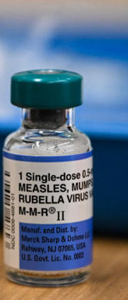
THE MEASLES, MUMPS, RUBELLA (MMR) VACCINE
VACCINATION SCHEDULE
VACCINE EFFICACY: The MMR vaccine is 93% effective against measles infection after 1 dose and 97% effective against measles infection after 2 doses. Receiving two doses of the measles vaccine protects individuals for life.
VACCINE SAFETY:
The most common side effects include mild rash, fever, and pain at the injection site. Serious reactions to the vaccine are rare.
MMR is contraindicated for individuals who are severely immunocompromised or allergic to any of its ingredients. HIV-positive individuals can receive MMR but not MMRV.
VACCINE AVAILABILITY:
The two MMR vaccines available in the U.S. are M-M-R II® and PRIORIX®.
Measles, mumps, rubella, and varicella (MMRV) vaccine is also available and marketed as ProQuad®.
TRANSPORTATION AND STORAGE:
All three measles-containing vaccines require refrigeration during transport and storage.
Specific temperature ranges vary by vaccine type.
All three must be protected from light, which inactivates the vaccine.
INFANTS 6-11 MONTHS
Emergency vaccination: Administer an early dose of measles, mumps, and rubella (MMR) vaccine between 6 - 11 months.
Administer a second dose at 12 - 15 months
Administer a third dose at 4 - 6 years.
CHILDREN 12 MONTHS OR OLDER
Routine vaccination: 2 dose series. The first dose is administered at age 12 through 15 months, and the second dose at age 4 - 6 years.
Emergency vaccination: Administer 2 doses. The minimum interval between doses 1 and 2 is 4 weeks for MMR and 3 months for MMRV.
TEENS AND ADULTS WITH NO EVIDENCE OF IMMUNITY
Catch-up vaccination: Administer one dose immediately and follow with a second dose at least 28 days after the first.
POST-EXPOSURE PROPHYLAXIS FOR UNVACCINATED INDIVIDUALS EXPOSED TO MEASLES
Administer MMR vaccine within 72 hours of measles exposure OR
Administer immunoglobulin (IG) within 6 days of measles exposure. The recommended dose for intramuscular immunoglobulin (IMIG) is 0.5mL/kg, regardless of the contact’s immune status.
Don't administer MMR vaccine and IG simultaneously, as this
invalidates the vaccine.
SOURCES: CDC, CDC, CDC, WHO, UNICEF, CHOP, TIME

Slide 8
HOSPITAL AND CLINICS
As of 3/4/2025 – 22 cases have been hospitalized in Texas and there has been 1 fatality
TEXAS
Seminole Hospital District: Has admitted several measles patients and transferred several to Covenant Children’s Hospital in Lubbock for higher levels of care. The hospital is offering MMR vaccines.
Covenant Children’s Hospital:- Lubbock: At least 20 children have been admitted. Some have needed higher-level care, such as respiratory support. Several children are critically ill, one has recently died. None of the hospitalized children were vaccinated.
University Medical Center—Lubbock: Has opened a mobile clinic in the Seminole Hospital District parking lot to help with titration efforts to determine immunity levels among community members.
Lynn County Healthcare System: This system runs the hospital for rural Lynn County and several community clinics. LCHS encourages individuals with symptoms to contact their healthcare provider and South Plains Health District and to receive the MMR vaccine.
Medical Center Health System—Odessa: Serves Ector County and has begun automatically screening patients at their hospital and associated clinics for measles. Encouraging similar measures to Lynn County Healthcare System.
CVS Pharmacy Minute Clinics: In Lubbock and Seminole are also now offering MMR vaccines for those who are unvaccinated but are encouraging patients to call ahead first to confirm vaccines are still in stock.
NEW MEXICO
Nor-Lea Hospital District: Was identified as an exposure location in Lea County. They are using the following procedures for suspected measles cases:
  Asking exposed patients to call ahead for phone screening.
  Asking patients to mask up and wait in their vehicles if they are experiencing measles-like symptoms or have had any known exposures.
  Using unspecified infection control protocols during visits with persons experiencing symptoms to minimize and contain exposure.
Mesilla Valley Pharmacy: Las Cruces Public Schools (LCPS) is partnering with Mesilla Valley Pharmacy to offer MMR vaccines to LCPS students, staff, and families. Asking exposed patients to call ahead for phone screening.
  The vaccine clinic will be held on Wednesday 3/5/2025 at Mesilla Valley Pharmacy, 4119 White Sage Arc, Suite E, from 8:00 am to 7:00 pm.
  Insurance coverage is required to receive the vaccine
  Contact Mesilla Valley Pharmacy at (575) 323-2093 for more information .
SOURCES: NBC News, Associated Press, Texas Standard, , NMDOH, Nor-Lea Hospital District, KCBD, Becker’s Hospital Review, Facebook,. Dallas Morning News, Las Cruces Public Schools, Texas DSHS

Slide 9
LOCAL GOVERNMENT RESPONSE
COUNTY-LEVEL PUBLIC HEALTH AUTHORITIES IN TEXAS
All public health departments involved are encouraging those who have been exposed to a measles case or who are showing symptoms to shelter in place and call their health professional immediately. If they do not have a regular health provider, they’re told to call their local health department. Those who have not yet been vaccinated are also being encouraged to receive the vaccine.
COUNTY-LEVEL PUBLIC HEALTH AUTHORITIES IN NEW MEXICO
The Lea County Health Department offers free measles vaccination clinics at the Hobbs Public Health Office. The general instructions for those exposed in the county echo Texas County Authorities’ response.
  Residents are encouraged to call the Department of Health Helpline at 1-833-796-8773 for questions about measles, vaccines, case reporting, vaccination records, and guidance on measles exposure. The helpline also provides information on local pharmacies with vaccines in stock and helps coordinate vaccinations with public health offices.
  High-risk adults—such as college students, international travelers, and healthcare personnel—are urged to receive two doses of the MMR vaccine.
South Plains Public Health District: This district covers four counties at the center of the outbreak: Terry, Dawson, Yoakum, and Gaines.
  Four clinics operate in the area, offering scheduled and walk-in MMR vaccinations. Interpreters are available at their clinics.
  Jointly operating mobile testing units outside schools and staffing clinics that can provide prophylactic treatment for infants exposed to the virus.
Advising daycare centers on protecting young children and infants and educating school nurses on identifying signs of disease.
Lubbock Public Health Department: Health Department director Katherine Wells stated that 75% of her staff were being put on this outbreak. MMR vaccine clinic in 2015 50th Street is offering vaccines at no cost with no appointment necessary.
Ector County Health Department:
  MMR vaccination for uninsured and Medicaid patients for individuals under the age of 26 on March 6th. They recommend pre-registering for the clinic.
  Conducting contact tracing for cases reported within the county.
The Dallam-Hartley County Hospital District (DHCHD): Encourages all residents who would like to be vaccinated, or who are unsure of their vaccination status, to contact the Dalhart Family Medical Clinic (DFMC). DFMC has the MMR vaccine available for those who need it. Contact the DFMC to schedule an appointment at 806-244-5668, or to consult their healthcare provider.
SOURCES: NBC News, Texas DSHS, KFF Health News, KCBD, Ector County, Lubbock Public Health, South Plains Health, NMDOH

Slide 10
STATE RESPONSE
TEXAS
For unvaccinated and already exposed, the DSHS advises administering immunoglobulin (IG) within six days of initial exposure for partial protection. IG is available at local hospitals and health departments, especially for those under the age of 1.
Those who have been exposed to someone with measles:
  Self-isolate to prevent further spread.
  Contact their healthcare provider before arriving for testing to minimize additional exposure.
DSHS:
Recommends that providers send specimens to the DSHS Laboratory for PCR testing, identification, and genotyping.
Offers measles PCR and serology (IgM and IgG) testing at the state laboratory.
Requests that clinicians report cases to DSHS or their local health department.
Set up faster processing in Austin lab. Equipped nearby Texas Tech with necessary resources to process specimens.
Set up 2 specimen collection sites in the outbreak area open 7 days a week.
Deployed 4 strike teams to collect specimens in high impacted areas, employed surge staffing and 24/7 contractors, brought in CDC physicians and epidemiologists.
Provides messaging about the Measles Outbreak, availability of vaccines, public health education efforts through billboards and social media.
Provides health alerts in rural hospitals and hospital planning for ICU pediatric beds.
DSHS Region 1 Office:
Is leading the outbreak response. The outbreak response team recommends that unvaccinated individuals in the affected area receive the MMR vaccine per the CDC schedule, either preventatively or within 72 hours of exposure
NEW MEXICO
New Mexico Department of Health (NMDOH):
If measles is suspected, NMDOH has asked clinicians to immediately notify them by calling 1-833-SWNURSE, option 4 (1-833-796-8773) for further guidance and testing approval. They’ve also released a list of potential community exposures.
Clinicians are also being asked to obtain a throat swab or nasopharyngeal swab in viral transport medium for PCR testing at the State Public Health Laboratory.
NMDOH recommends that patients with suspected measles (fever and rash) not be allowed in the waiting room with others. If measles is suspected, the patient should wear a mask and immediately be isolated in a negative pressure room.
Appointments for MMR vaccines are available for those without insurance at the New Mexico Department of Health, Ben Archer Clinics, or La Clinica de Familia clinics.
More than 800 people have been involved in contract tracing and more than 5,135 MMR vaccines have been provided statewide.
SOURCES: Texas Department of State Health Services, South Plains Health, NMDOH

Slide 11





PRIORITY OF NEEDS
CONTAINMENT & CASE MANAGEMENT
Identification & Isolation: Isolate confirmed and suspected measles cases in hospitals (airborne precaution rooms) and at home.
Quarantine & Contact Tracing: Identify exposed individuals and advise quarantine for those at risk.
Hospital Support: Ensure adequate beds, staff, and supplies to manage cases. Strict isolation measures to prevent nosocomial transmission.
HEALTHCARE SYSTEM SUPPORT
PPE: Ensure that PPE is available for doctors and hospital staff who may be examining and caring for infected individuals.
Medical Supplies: Ensure hospitals and clinics have adequate stock of measles-related treatments, IV fluids, and ventilators.
Healthcare Worker Support: Deploy additional staff where hospitals are overwhelmed.
Surge Capacity Planning: Prepare for an increase in hospital admissions and outpatient cases.
SURVEILLANCE & DATA MONITORING
Real-Time Case Tracking: Strengthen surveillance systems to monitor new cases.
Testing & Lab Support: Expand laboratory capacity to quickly confirm cases and identify outbreak trends.
VACCINATION CAMPAIGN & PUBLIC HEALTH MESSAGING
Emergency Vaccination Drive: Immediate measles-mumps-rubella vaccinations, targeting unvaccinated children and high-risk groups.
Community Outreach: Public education on vaccination to combat misinformation and vaccine hesitancy.
Mobile Vaccination Clinics: Deploy clinics in low-coverage areas, schools, and workplaces.
Additional Vaccine Doses: Either MMR II or PRIORIX for prophylactic use.
Post-exposure Prophylaxis: Human immunoglobulin (IG) given within 6 days of exposure to measles in susceptible individuals.
Vitamin A Supplementation: The American Academy of Pediatrics recommends high doses of Vitamin A to all children with severe measles to reduce risk of death and complications.
Educate about the modes of transmission to minimize spread
Outbreak
Area
Unexposed
General Population
- Enhanced Surveillance
Exposed S
Unexposed
- Collect Data
Unexposed
Index Case
Offer PEP
(Vaccine, IG)
Vaccinate
or
Exclude from outbreak area
Confirm, and genotype (lab)
Proper Case Management
Exposed S
Quarantine
(If outside PEP window)
Assemble outbreak response committee • Determine coverage in affected and surrounding areas
Inform public and health authorities
ABBREVIATIONS: I = Immune; S = Susceptible; IG = Immunoglobulin; PEP = Post-exposure prophylaxis
Measles virus transmission and measles disease burden can be mitigated through vaccination of susceptible persons, administration of post-exposure prophylaxis (vaccine and immunoglobulin), and social distancing techniques (isolation, quarantine, and exclusion). In elimination settings, where general population immunity is high, outbreak response is prioritized in areas with a high risk of transmission or among persons at risk of severe disease.
SOURCES: Public Health Response During Measles Outbreaks

Slide 12
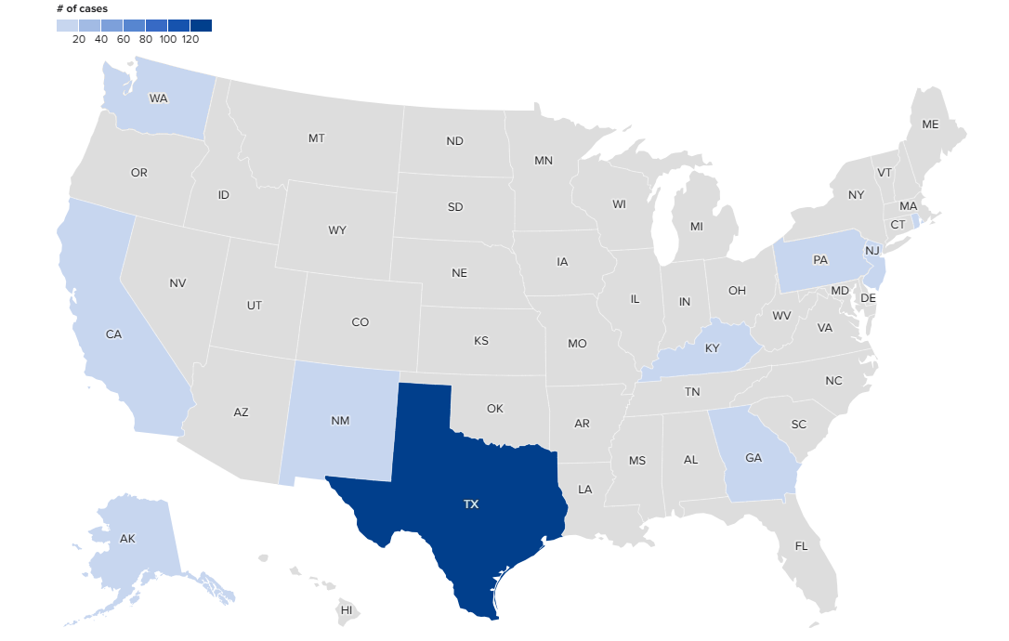
NATIONAL CASES IN 2025 AND GOVERNMENT COORDINATION
189*
STATE | CASES
ALASKA | 2
CALIFORNIA | 3
GEORGIA | 3
KENTUCKY | 1
NEW MEXICO | 9
NEW YORK CITY | 2
NEW JERSEY | 3
PENNSYLVANIA | 1
RHODE ISLAND | 1
TEXAS | 163 **
WASHINGTON | 1
TOTAL | 189
* NOTE: The information on this page has been gathered by reviewing data from several health departments and news media sources.
**TEXAS CASES NOT ASSOCIATED WITH OUTBREAK
2 cases - Adults, Harris County (travel-related)
1 case - Infant, Travis County (travel-related)
1 case - Adult, Rockwell County (travel-related)
TEXAS CASES ASSOCIATED WITH THE OUTBREAK: 159
HHS is providing technical assistance, laboratory support, vaccines, and therapeutic medication as needed to the Texas Department of State Health Services and New Mexico Department of Health, which are leading the responses to the outbreaks in their jurisdictions.
The CDC continues to communicate closely with Texas health authorities about the measles outbreak in West Texas. It has deployed teams from the Epidemic Intelligence Service to assist in contact tracing and has provided additional MMR vaccines.

Slide 13
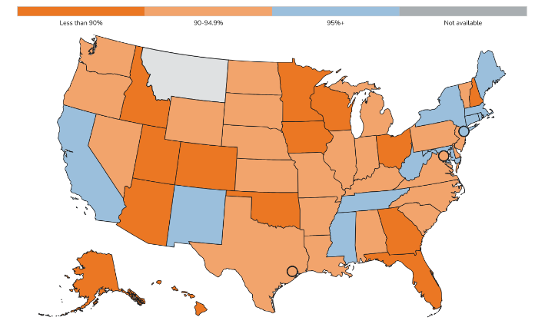
MMR VACCINE COVERAGE FOR KINDERGARTENERS BY SCHOOL YEAR (2023-2024)
STATE | PERCENT
Alabama | 93.80%
Alaska | 84.30%
Arizona | 89.30%
Arkansas | 92.50%
California | 96.20%
Colorado | 88.30%
Connecticut | 97.70%
Delaware | 93.80%
District of Columbia | 92.00%
Florida | 88.10%
Georgia | 88.40%
Hawaii | 89.80%
Houston | 93.60%
Idaho | 79.60%
Illinois | 91.60%
Indiana | 90.80%
Iowa | 89.10%
Kansas | 90.40%
Kentucky | 90.00%
Louisiana | 92.40%
Maine | 97.50%
Maryland | 96.60%
Massachusetts | 96.30%
Michigan | 92.10%
Minnesota | 87.00%
Mississippi | 97.50%
Missouri | 90.40%
Nebraska | 93.90%
Nevada | 91.90%
STATE | PERCENT
New Hampshire | 89.20%
New Jersey | 93.20%
New Mexico | 95.00%
New York | 97.70%
New York City | 96.70%
North Carolina | 93.80%
North Dakota | 91.00%
Ohio | 89.20%
Oklahoma | 88.30%
Oregon | 91.20%
Pennsylvania | 93.50%
Rhode Island | 97.10%
South Carolina | 92.10%
South Dakota | 90.80%
Tennessee | 95.10%
Texas | 94.30%
Utah | 88.80%
Vermont | 92.90%
Virginia | 94.20%
Washington | 91.30%
West Virginia | 98.30%
Wisconsin | 84.80%
Wyoming | 93.50%
The measles, mumps, and rubella (MMR) vaccine is very safe and effective. When more than 95% of people in a community are vaccinated (coverage >95%), most people are protected through community immunity (herd immunity).
Vaccination coverage among U.S. kindergartners has decreased from 95.2% during the 2019–2020 school year to 92.7% in the 2023–2024 school year.
SOURCES: CDC, SchoolVaxView

Slide 14
RISK COMMUNICATIONS AND VACCINE HESITANCY
RISK COMMUNICATIONS
MMR VACCINE HESITANCY
Effective risk communication about measles involves clear, transparent, and targeted messaging to inform the public, reduce misinformation, and promote preventive actions. Here’s a structured approach:
MMR vaccine hesitancy stems from misinformation, distrust, safety concerns, low perceived risk, social influence and myths about natural immunity. Religious and personal beliefs can also play a role. Clear communication and trust-building are key to addressing it. Consider these strategies:
Understand Concerns – Hesitancy stems from misinformation, distrust, religious beliefs, or complacency.
Communicate Clearly – Use empathetic, simple language, evidence-based facts, and compelling stories.
Combat Misinformation – Gently debunk myths, use visuals, and reinforce facts.
Build Trust in Providers – Encourage open dialogue, train healthcare workers in motivational interviewing, and highlight expert endorsements.
Emphasize Risks & Community Protection – Explain disease dangers and the importance of herd immunity.
Improve Access – Offer free, convenient vaccination options.
Engage Trusted Voices – Leverage community leaders and influencers to promote vaccination.
Clear & Transparent Messaging – Use simple, fact-based language to explain measles risks, vaccine benefits, and outbreak prevention.
Address Misinformation – Proactively debunk myths, clarify vaccine safety, and use trusted sources.
Targeted Communication – Tailor messages to specific audiences (e.g., parents, schools, healthcare workers) using culturally relevant approaches.
Leverage Trusted Voices – Engage doctors, community leaders, and influencers to reinforce pro-vaccine messaging.
Emphasize Urgency & Prevention – Highlight the dangers of measles and the role of vaccination in protecting individuals and communities.
Ensure Accessibility – Provide multilingual resources, easy-to-understand visuals, and convenient vaccine access points.
SOURCES: NIH, CDC, Voices for Vaccines – MMR, Immunize.org, CDC Measles Resources

Slide 15
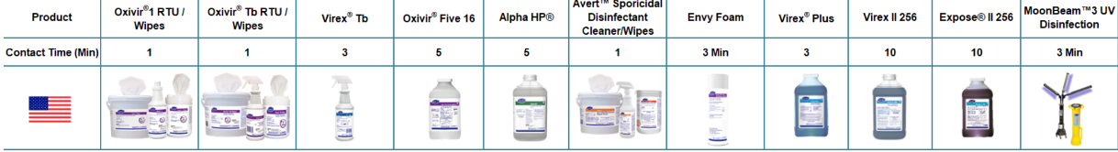
INFECTION CONTROL
Measles is one of the most contagious of all infectious diseases. Transmission can be mitigated by following sanitation and hygiene best practices.
VIRAL TRANSMISSION:
Direct contact with infectious droplets.
Airborne spread when an infected person breathes, coughs, or sneezes.
Measles can survive in the air for up to 2 hours.
Most commonly acquired from people in the household or community but can be spread in healthcare settings.
CORE PREVENTION IN HEALTHCARE SETTINGS:
Ensure healthcare personnel (HCP) have presumptive evidence of immunity (acquired or vaccinated).
Rapidly identify and isolate patients with known or suspected measles.
Minimize potential measles exposures by rapidly identifying and isolating patients with suspected measles.
Adhere to standard and airborne precautions:
  Place suspected or known cases in an airborne infection isolation room (AIIR).
  If an AIIR is not available, transfer the patient as soon as possible to an equipped facility.
  Adhere to proper protocols for using an AIIR.
Manage visitor access and movement within a facility.
Monitor unprotected exposures of HCP to infected patients:
  In a shared air space with an infectious measles patient at the same time.
  In a shared air space vacated by a measles patient within the prior 2 hours.
ENVIRONMENTAL INFECTION CONTROL:
Follow standard cleaning and disinfection procedures:
  Use cleaners and water to pre-clean surfaces prior to applying disinfectants to frequently touched surfaces or objects for indicated contact times.
Use an EPA-registered disinfectant for healthcare settings.
Manage used, disposable PPE and other patient care items for measles patients.
SOURCES:: CDC Infection Control Measles ; Disinfectant Protocol for Measles

Slide 16
CONTACTS AND CONTRIBUTORS
The Virtual Medical Operations Center Briefs (VMOC) were created as a service-learning project by faculty and graduate students at the Yale School of Public Health in response to the 2010 Haiti Earthquake. Each year, the VMOC Briefs are produced by students enrolled in EHS 581 - Public Health Emergencies: Disaster Planning and Response. These briefs compile diverse information sources - including status reports, maps, news articles, and web content—into a single, easily digestible document that can be widely shared and used interactively.
Key features of this report include:
Comprehensive Overview: Provides situation updates, maps, relevant news, and web resources.
Accessibility: Designed for easy reading, wide distribution, and interactive use.
Collaboration: The “unlocked" format enables seamless sharing, copying, and adaptation by other responders.
The students learn by doing, quickly discovering how and where to find critical information and presenting it in an easily understood manner.
Yale MPH Student Contributors:
Vanessa Evardone
Lucy Gilchrist
Nayeli Gonzalez-Vazquez
Monica Gomes
Rachel Kane
Nathan Lai
Elly Maldur
Shoa Moosavi
Bryn Redal
Christina Tong
LTC (R) Joanne McGovern – Joanne.McGovern@yale.edu
Lecturer, Department of Environmental Health Sciences, Yale School of Public Health

