Slide 1
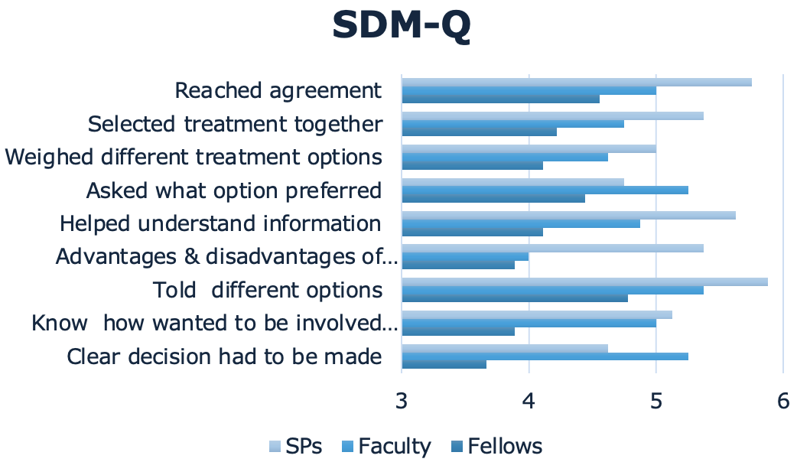
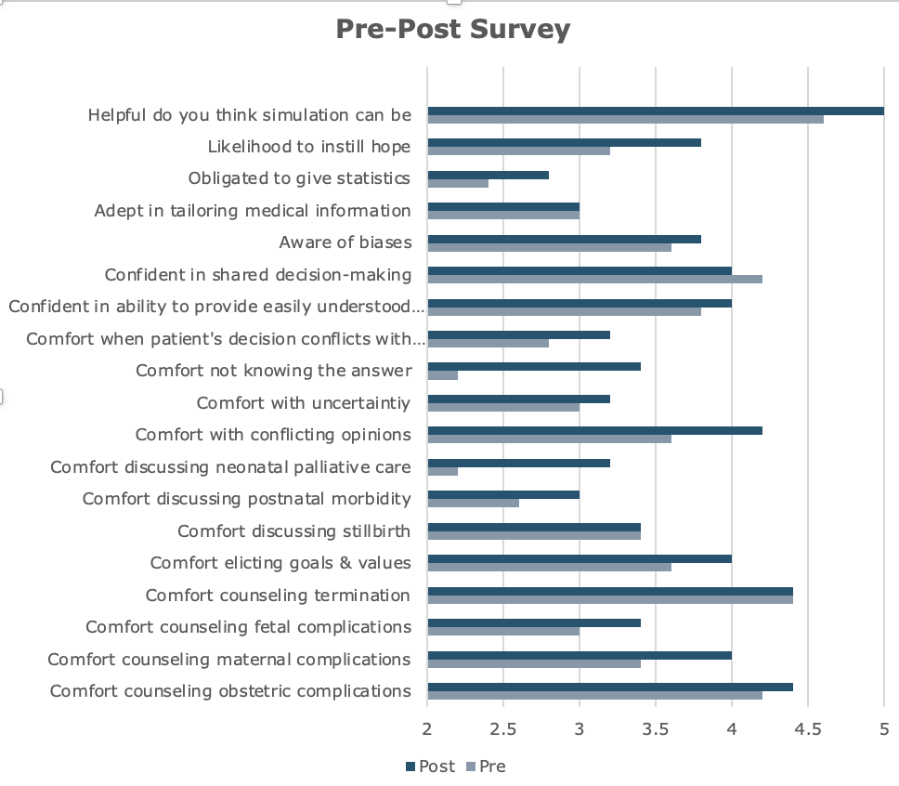

Development of a perinatal counseling curriculum for Maternal-Fetal Medicine fellows using standardized patients
Sarah N. Cross, MD
Associate Professor
Obstetrics, Gynecology & Reproductive Sciences
Barbara Hildebrand
Janice Crabtree, MS/6th Yr. Cert
Introduction/Background
Simulation with standardized patients improved MFM fellows’ comfort level with high stakes perinatal counseling
Patients with perinatal complications need to partner with physicians to make a series of high stakes decisions. Obstetric trainees have inconsistent and infrequent opportunities to learn shared decision making.
Simulation with standardized patients (SPs) can be a way to effectively practice these high stakes, low frequency interactions, potentially improving trainees’ comfort and skills.
Objectives
Creation and implementation of a 3-year curriculum in perinatal counseling for MFM Fellows.
Evaluation of the effectiveness of SP encounters to practice counseling.
Fellows express increased comfort with & improved perception of their perinatal counseling skill.
Over time, fellows’ self-assessment and faculty/SP assessment of shared decision making will improve.
Methodology
Designed and implemented two standardized, two-part, time-lapsed cases for MFM fellows (n=5) to counsel an SP.
MFM faculty were recruited to observe and provide feedback.
Trainees completed pre- and post-simulation knowledge and comfort self-assessment surveys using a 5-point Likert scale.
Post-simulation survey also assessed how well they received the experience.
The trainee, the SP, and the faculty filled out the validated SDM-Q (shared decision-making questionnaire).
Fellows rated themselves more harshly than faculty & SPs
Results
Improvements were seen in fellows’ assessment of comfort with perinatal counseling, when comparing the pre- and post-test in the following areas:
Comfort with obstetric, maternal and fetal complications
Eliciting patients’ goals & values
Discussing post-natal morbidity & perinatal palliative care
Comfort with medical uncertainty & not knowing the answer to a patient’s question
Comfort with using language that is easily understood; when patients make a choice that is perceived not to be in their best interest; being aware of biases; and instilling hope.
References
QR CODE
Increased comfort was seen in multiple areas of counseling

